Slide 1

Holmusk Healthcare Dataset Challenge
By Teh Tian Yan Updated on: 10 Dec 2021

Slide 2
Abstract
Drivers of Cost of Care:
Age
Race (Chinese / Malay)
Resident Status (Singaporean/ Foreigner)
Symptoms (3 & 5)
A Multiple Linear Regression was fitted to explain the relationship of these drivers to the patient’s hospitalization cost.

Slide 3
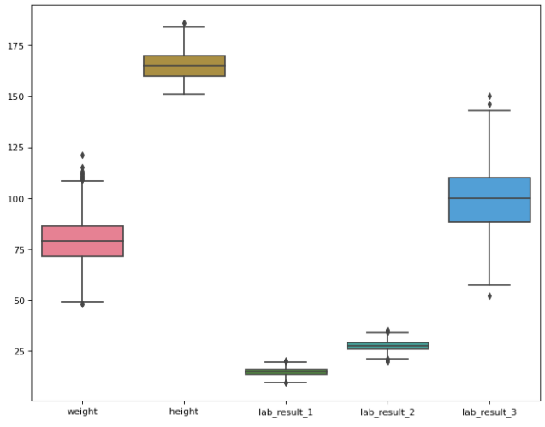
Data Exploration

Slide 4
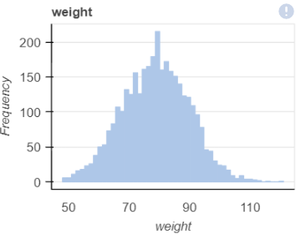
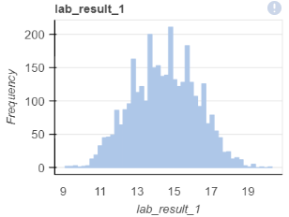
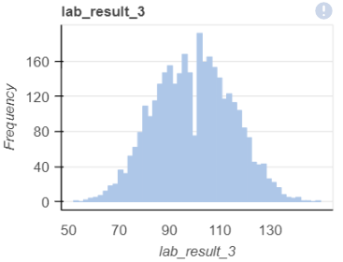
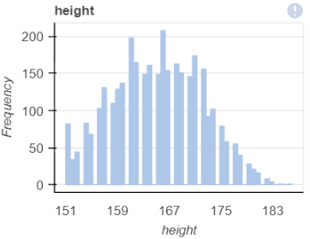

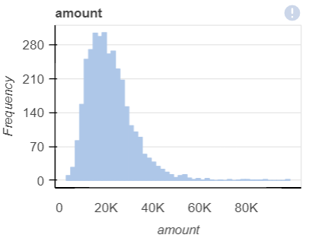
Data Exploration
The continuous predictors are normally distributed.
The continuous response variable is right-skewed distribution.

Slide 5
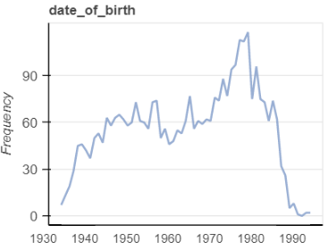
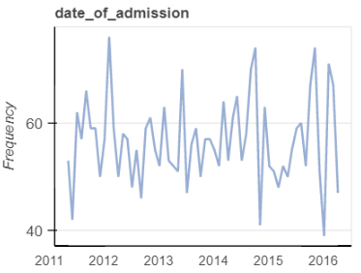
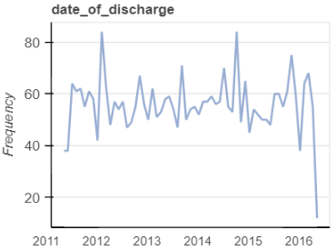
Data Exploration
3 date datatype

Slide 6
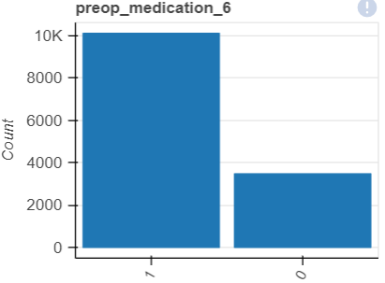
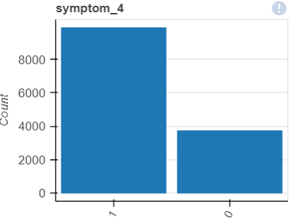
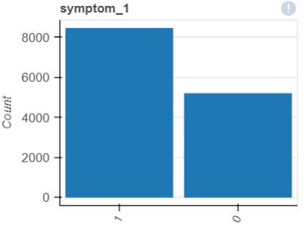
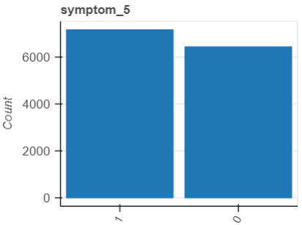
Data Exploration
21 categorical data:
Gender
Race
Resident status
Medical_history (1 – 7)
Preops Medication (1 – 6)
Symptom (1 – 5)

Slide 7
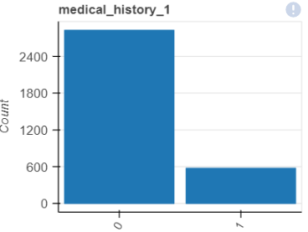
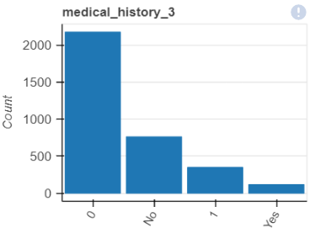
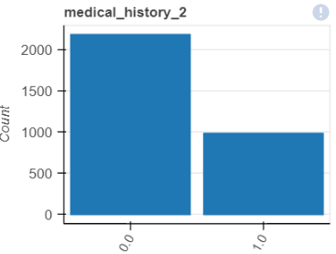
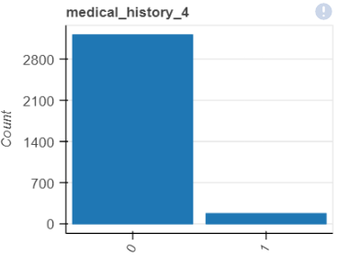
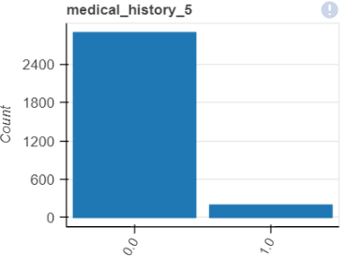
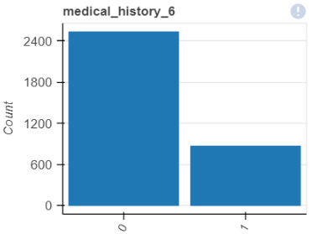
Data Exploration

Slide 8
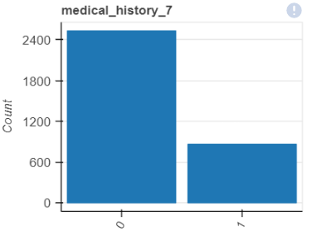
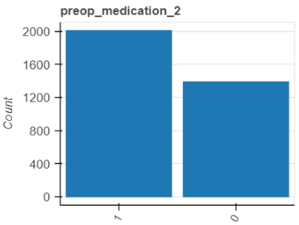
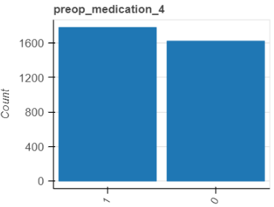
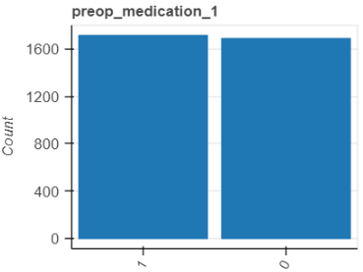
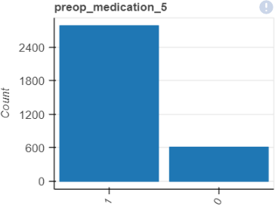

Data Exploration

Slide 9

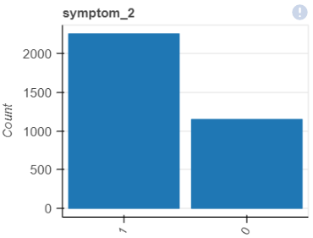
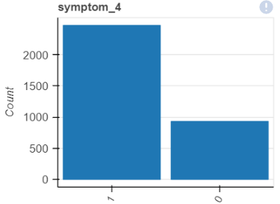
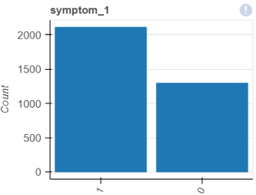
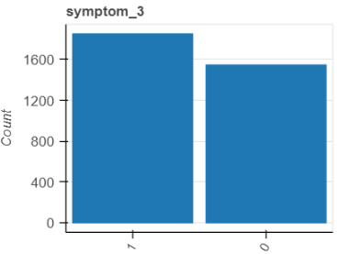
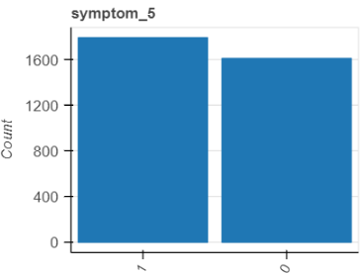
Data Exploration

Slide 10
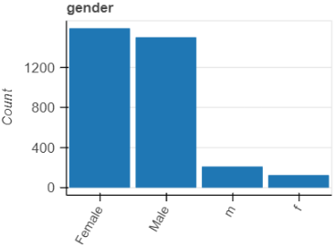
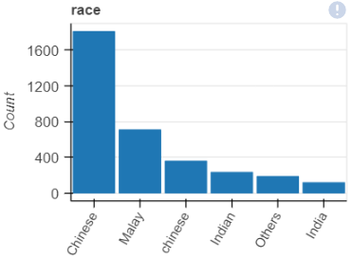
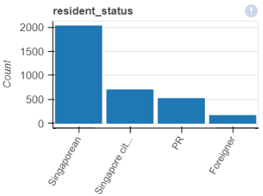
Data Exploration

Slide 11
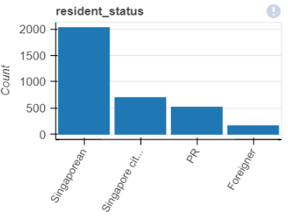
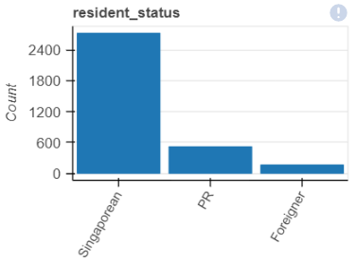
Data Pre-processing
Examples of data cleaning done:
Medical_history_3 (Changed “No” to 0, “Yes” to 1)
Gender (Standardized “F” and “Female” to “Female” only, same for “M”)
Race (Standardized “India” and “Indian” to “Indian” only)
Resident_status (Standardized “Singaporean Citizen” and “Singaporean” to “Singaporean” only)

Slide 12
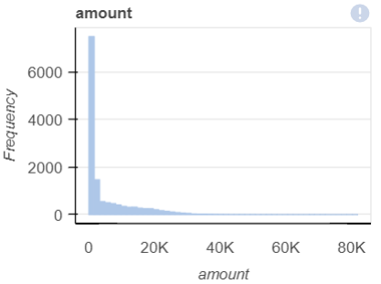
Data Pre-processing
Aggregate bill amounts data to by “patient_id” and “date_of_admission”.
Log transformed the response variable.
Added new features:
Age
Hospitalisation duration in days
No. of hospitalisations to date.
Aggregate by hospitalization visit

Slide 13
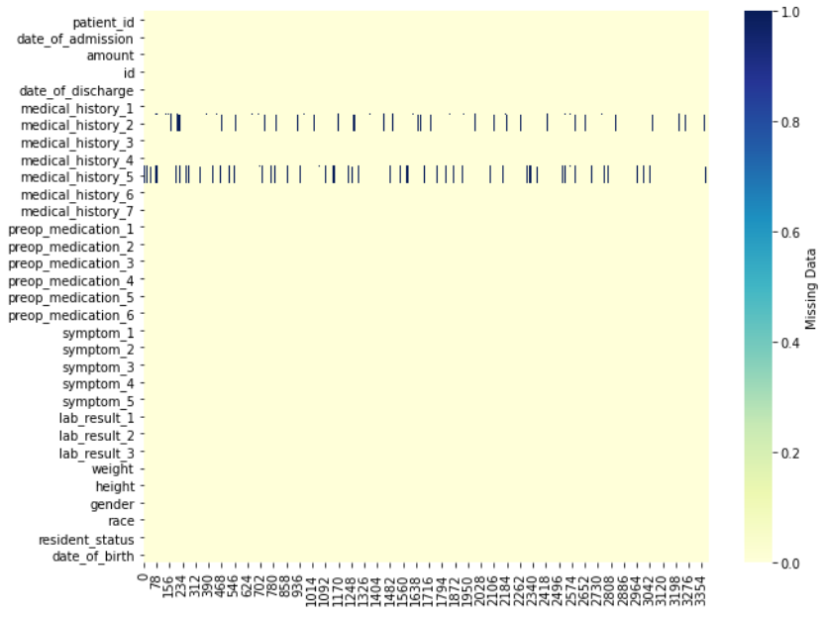
Missing values
6.85% of “medical_history_2” data is and 8.94% of “medical_history_5” data were missing from the dataset.
Assumptions:
Missing data are missing completely at random (MCAR).
Medical histories are lifelong conditions that remains constant in a patient’s life.
22.75% of missing data in “medical_history_2” and 21.71% of missing data in “medical_history_5” were restored based on existing patient records. The rest were imputed based on the modal class, “0”.

Slide 14
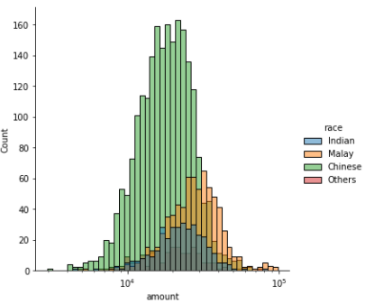
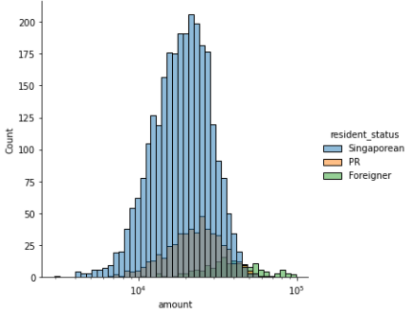
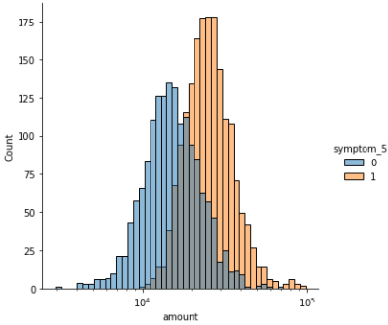
Preliminary Analysis
asdf

Slide 15
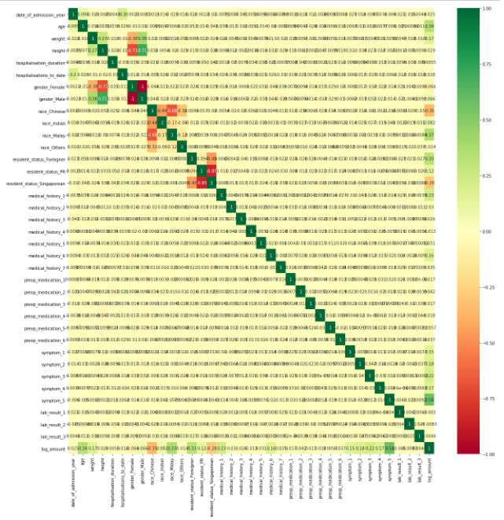
Feature Selection
The Pearson’s correlation matrix was used to assess correlation between the predictors to the response variable.
Collinearity can also be observed among the categorical data.
Feature selection is carried out to utilize predictors with maximum correlation with the response variable and minimum collinearity with other predictors.

Slide 16
Collinearity
Collinearity is measured using the Variance Inflation Factor (VIF). Ideally, predictors with a VIF < 5 is used for model fitting. This feature selection is conducted iteratively as removal of a predictor affects the VIF for other predictors.

Slide 17
Model Fitting
R-squared and RMSE metrics were used to measure goodness of fit.
AIC and BIC criterion metrics were used to compare the quality and parsimony of the model.
No. of variables | 22 | 10 | 8 | 7
R-squared | 0.982 | 0.969 | 0.969 | 0.969
RMSE | 1.3 | 1.75 | 1.69 | 1.7
AIC | 8712 | 1.01E+04 | 1.01E+04 | 1.01E+04
BIC | 8840 | 1.02E+04 | 1.01E+04 | 1.02E+04

Slide 18
Discussions
Investigate the inflation of hospitalization cost on an annual basis using time series analysis (Naïve, ARIMA, etc).
Use Little’s MCAR test (one way chi squared test) to confirm the nature of missing data.
Apply the same assumption that the medical history is constant to the patient’s lifetime to the remaining medical history data.
Further research to be done on influenceable features (similar to weight, lab_result_1, lab_result_2, lab_result_3) and establish its relationship to hospitalization cost.

